Slide 1
Locking Techniques for Concurrency Control
Locking protocols
Locking protocols
Simple locking
Two phase locking
Basic 2PL
Conservative 2PL
Strict 2PL
Rigorous 2PL

Slide 2
Locking Techniques for Concurrency Control
Locking protocols
Simple locking:
A transaction is said to follow the Simple locking:
If it performs the read and write operations only after the lock acquisition
And release the lock once work is done
Now we will discuss two transactions that are executed concurrently after using simple locking protocol
Problem:
Simple locking doesn't always ensure serializability

Slide 3
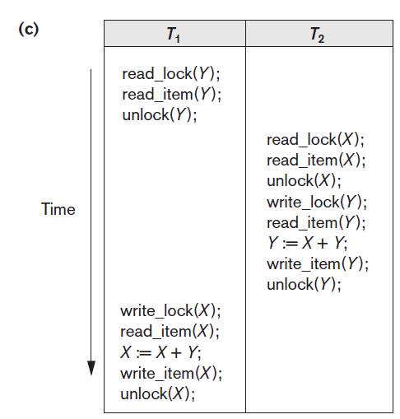
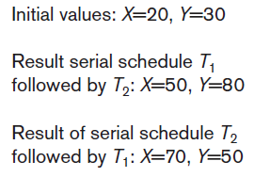
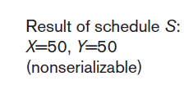
Locking Techniques for Concurrency Control
Simple Locking
Simple locking does not guarantee serializability.

Slide 4
Two-Phase Locking Techniques for Concurrency Control
Guaranteeing Serializability by Two-Phase Locking
A transaction is said to follow the two-phase locking (2PL) protocol if:
all locking operations (read_lock, write_lock) are done before the first unlock operation in the transaction.
Such a transaction can be divided into two phases:
expanding or growing phase,
In this phase, new locks on items can be acquired
but no lock can be released even if the data item is no more needed.
shrinking phase,
All existing locks can be released
and no new locks can be acquired.

Slide 5
Two-Phase Locking Techniques for Concurrency Control
Guaranteeing Serializability by Two-Phase Locking
Lock point:
The point at which locking ends and unlocking starts
This point helps in defining serializable schedules
Problems in Basic 2PL:
May limit the amount of concurrency between transactions
Unnecessary lock acquisition even if the item is not needed right now. i.e., early locking
This is the price for guaranteeing serializability without having to check the schedules them selves
Deadlocks might occur
cascading rollback is needed

Slide 6
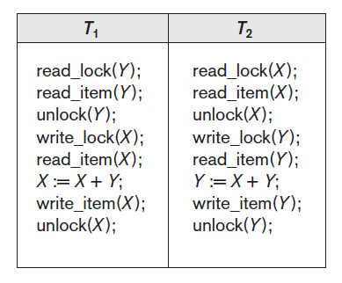
Two-Phase Locking Techniques for Concurrency Control
Guaranteeing Serializability by Two-Phase Locking
Transactions T1 and T2 violates the 2PL protocol because:
the write_lock(X) operation follows the unlock(Y) operation in T1,
Similarly, the write_lock(Y) operation follows the unlock(X) operation in T2.

Slide 7
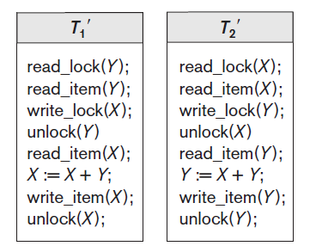
Two-Phase Locking Techniques for Concurrency Control
Guaranteeing Serializability by Two-Phase Locking
After enforcing 2PL, the transactions can be rewritten as T1′ and T2′.
Now, the schedule shown is not permitted for T1′ and T2′ because T1′ will issue its write_lock(X) before it unlocks item Y.
Consequently, when T2′ issues its read_lock(X), it is forced to wait until T1′ releases the lock by issuing an unlock (X) in the schedule.
However, this can lead to deadlock.

Slide 8
Two-Phase Locking Techniques for Concurrency Control
Guaranteeing Serializability by Two-Phase Locking
Problem in Basic 2PL:
As we have discussed earlier that 2PL may limit the amount of concurrency that can occur in a schedule because:
a transaction T may not be able to release an item X even though it is done with X because it has to acquire a lock for a data item Y
Or transaction T must lock the additional item Y before it needs it so that it can release X.

Slide 9
Two-Phase Locking Techniques for Concurrency Control
Basic, Conservative, Strict, and Rigorous Two-Phase Locking
There are number of variations of 2PL namely,
Basic 2PL (the one discussed in the preceding slides)
Conservative/static 2PL
Strict 2PL
Rigorous 2PL

Slide 10
Two-Phase Locking Techniques for Concurrency Control
Basic, Conservative, Strict, and Rigorous Two-Phase Locking
Conservative 2PL (or static 2PL):
requires a transaction to lock all the items it is going to access in future before the transaction begins execution,
by predeclaring its read-set and write-set.
Advantages:
Deadlock free
Problem:
Cascading roll back

Slide 11
Two-Phase Locking Techniques for Concurrency Control
Basic, Conservative, Strict, and Rigorous Two-Phase Locking
Strict 2PL:
a transaction T does not release any of its exclusive (write) locks until after it commits or aborts.
We have growing phase in which locks are acquired
Shrinking phase will release only read locks , once the commit is done only then Write locks are unlocked.
Advantages:
No dirty read problem
Problem:
Can have Deadlock as locks are acquired in growing phase

Slide 12
Two-Phase Locking Techniques for Concurrency Control
Basic, Conservative, Strict, and Rigorous Two-Phase Locking
Rigorous 2PL:
A transaction T does not release any of its locks (exclusive or shared both) until after it commits or aborts.
Problem:
Can have Deadlock as locks are acquired in growing phase

Slide 13
Two-Phase Locking Techniques for Concurrency Control
Basic, Conservative, Strict, and Rigorous Two-Phase Locking
The difference between conservative and rigorous 2PL:
The former must lock all its items before it starts, so once the transaction starts it is in its shrinking phase; the latter does not unlock any of its items until after it terminates (by committing or aborting), so the transaction is in its expanding phase until it ends.
The use of locks can causes two additional problems: deadlock and starvation.

